Slide 1
jQuery Essentials

Slide 2




We needed a hero to get these guys in line

Slide 3


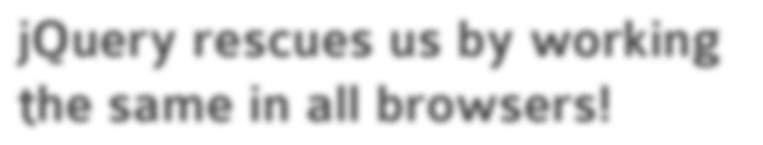
jQuery rescues us by working the same in all browsers!

Slide 4
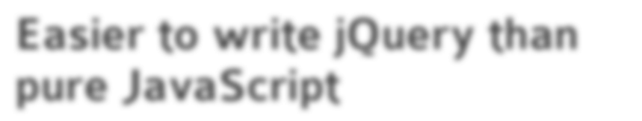
Easier to write jQuery than pure JavaScript

Slide 5

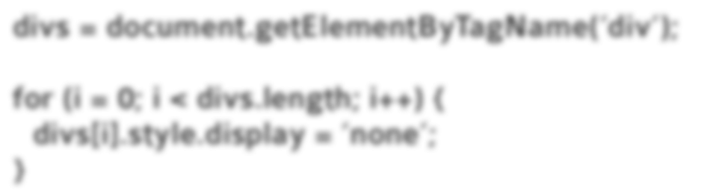
Hide divs with pure JavaScript
divs = document.getElementByTagName(‘div’);
for (i = 0; i < divs.length; i++) { divs[i].style.display = ‘none’;
}

Slide 6


Hide divs with pure JavaScript
divs = document.getElementByTagName(‘div’);
for (i = 0; i < divs.length; i++) { divs[i].style.display = ‘none’;
}
Hide divs with jQuery
$(“div”).hide();

Slide 7

HTML is tied to JavaScript

Slide 8

jQuery Philosophy

Slide 9

jQuery Philosophy
#1. Find some HTML

Slide 10
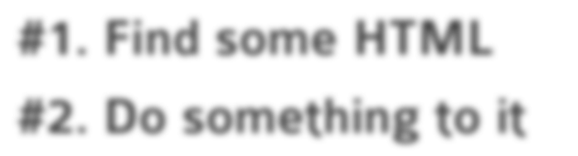
jQuery Philosophy
#1. Find some HTML #2. Do something to it

Slide 11


Slide 12

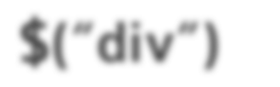
Find
$(“div”)

Slide 13
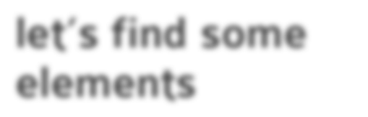
Find
let’s find some elements
$(“div”)

Slide 14

Give $() a selector

Slide 16

Give $() a selector
$(“#myId”)

Slide 17

Give $() a selector
$(“#myId”) $(“.myClass”)

Slide 18

Give $() a selector
$(“#myId”) $(“.myClass”) $(“table”)

Slide 19

Selector Examples
$(“#content”) get element with id content

Slide 20

Selector Examples
$(“#content”) get element with id content
$(“li:first”) get first list item

Slide 21
Selector Examples
$(“#content”) get element with id content
$(“li:first”) get first list item
$(“tr:odd”) get odd numbered table rows

Slide 22
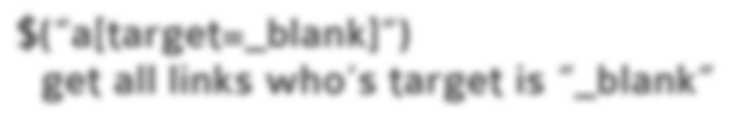
Selector Examples
$(“#content”) get element with id content
$(“li:first”) get first list item
$(“tr:odd”) get odd numbered table rows
$(“a[target=_blank]”)
get all links who’s target is “_blank”

Slide 23
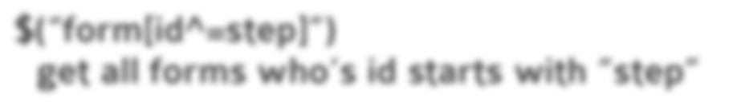
Selector Examples
$(“#content”) get element with id content
$(“li:first”) get first list item
$(“tr:odd”) get odd numbered table rows
$(“a[target=_blank]”)
get all links who’s target is “_blank”
$(“form[id^=step]”)
get all forms who’s id starts with “step”

Slide 24

You can also string selectors together

Slide 25

You can also string selectors together
$(“#myId, .myClass, table”)

Slide 26
Find
$(“div”)

Slide 27


Find Do
$(“div”).addClass(“redbox”);

Slide 28

jQuery API Spice
Two things that make the API HOT

Slide 29


Chain Methods
$(“div”).addClass(“redbox”)

Slide 30

Chain Methods
$(“div”).addClass(“redbox”).fadeOut();

Slide 31


One Method, Many Uses
$(...).html();

Slide 32

One Method, Many Uses
$(...).html();
$(...).html(“<p>hello</p>”);

Slide 33
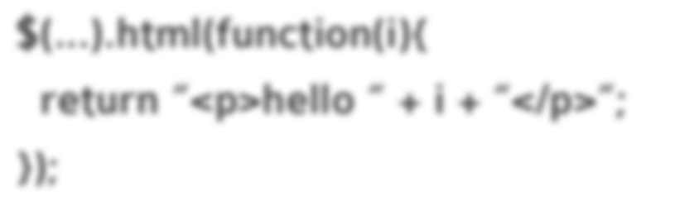
One Method, Many Uses
$(...).html();
$(...).html(“<p>hello</p>”);
$(...).html(function(i){
return “<p>hello “ + i + “</p>”;
});

Slide 34

jQuery Methods

Slide 35
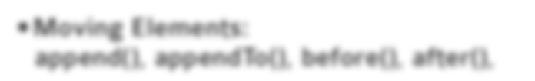
jQuery Methods
Moving Elements:
append(), appendTo(), before(), after(),

Slide 36
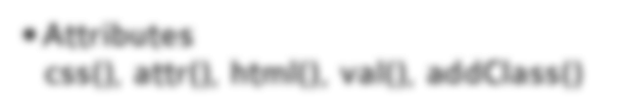
jQuery Methods
Moving Elements:
append(), appendTo(), before(), after(),
Attributes
css(), attr(), html(), val(), addClass()

Slide 37

jQuery Methods
Moving Elements:
append(), appendTo(), before(), after(),
Attributes
css(), attr(), html(), val(), addClass()
Events
bind(), trigger(), unbind(), live(), click()

Slide 38

jQuery Methods
Moving Elements:
append(), appendTo(), before(), after(),
Attributes
css(), attr(), html(), val(), addClass()
Events
bind(), trigger(), unbind(), live(), click()
Effects
show(), fadeOut(), toggle(), animate()

Slide 39
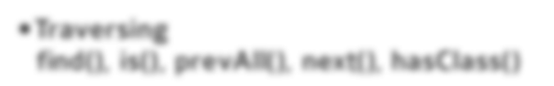
jQuery Methods
Moving Elements:
append(), appendTo(), before(), after(),
Attributes
css(), attr(), html(), val(), addClass()
Events
bind(), trigger(), unbind(), live(), click()
Effects
show(), fadeOut(), toggle(), animate()
Traversing
find(), is(), prevAll(), next(), hasClass()

Slide 40
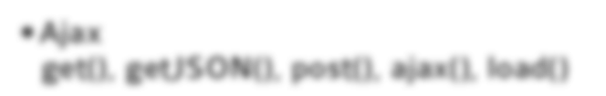
jQuery Methods
Moving Elements:
append(), appendTo(), before(), after()
Attributes
css(), attr(), html(), val(), addClass()
Events
bind(), trigger(), unbind(), live(), click()
Effects
show(), fadeOut(), toggle(), animate()
Traversing
find(), is(), prevAll(), next(), hasClass()
Ajax
get(), getJSON(), post(), ajax(), load()

Slide 41

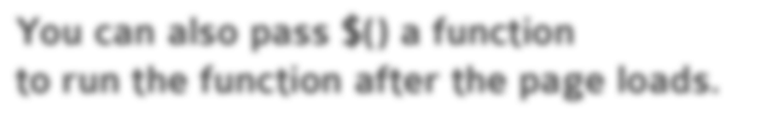
jQuery Factory Method $()
You can also pass $() a function
to run the function after the page loads.

Slide 42
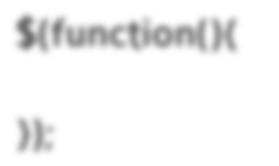
jQuery Factory Method $()
You can also pass $() a function
to run the function after the page loads.
$(function(){
});

Slide 43
jQuery Factory Method $()
You can also pass $() a function
to run the function after the page loads.
$(function(){
code here will execute after DOM is ready
});

Slide 44
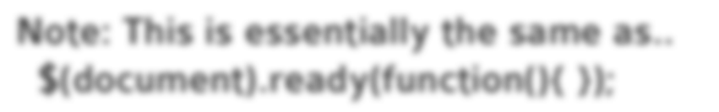
jQuery Factory Method $()
You can also pass $() a function
to run the function after the page loads.
$(function(){
code here will execute after DOM is ready
});
Note: This is essentially the same as..
$(document).ready(function(){ });

Slide 45
jQuery Factory Method $()
You can also pass $() a function
to run the function after the page loads.
$(function(){
code here will execute after DOM is ready
});
Note: This is essentially the same as..
$(document).ready(function(){ });
..you will see this in tutorials around the net

Slide 46


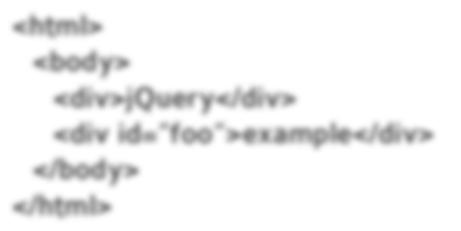
Moving Elements Examples
Get element with ID foo and add some HTML.
$(“#foo”)
<html>
<body>
<div>jQuery</div>
<div id=”foo”>example</div>
</body>
</html>

Slide 47

Moving Elements Examples
Get element with ID foo and add some HTML.
$(“#foo”).append(“<p>test</p>”);
<html>
<body>
<div>jQuery</div>
<div id=”foo”>example</div>
</body>
</html>

Slide 48
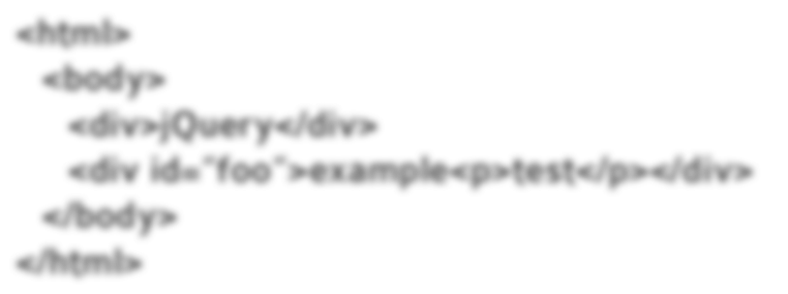
Moving Elements Examples
Get element with ID foo and add some HTML.
$(“#foo”).append(“<p>test</p>”);
<html>
<body>
<div>jQuery</div>
<div id=”foo”>example<p>test</p></div>
</body>
</html>

Slide 49

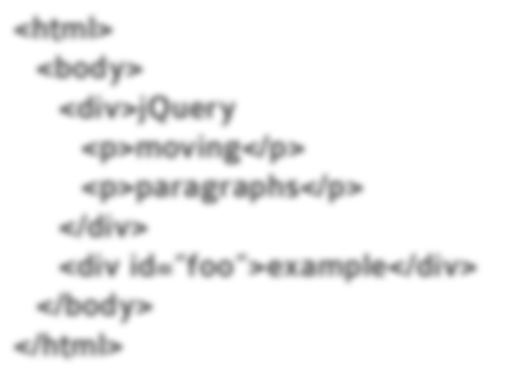
Moving Elements Examples
Move paragraphs to element with id “foo”
$(“p”)
<html>
<body>
<div>jQuery
<p>moving</p>
<p>paragraphs</p>
</div>
<div id=”foo”>example</div>
</body>
</html>

Slide 50

Moving Elements Examples
Move paragraphs to element with id “foo”
$(“p”).appendTo(“#foo”);
<html>
<body>
<div>jQuery
<p>moving</p>
<p>paragraphs</p>
</div>
<div id=”foo”>example</div>
</body>
</html>

Slide 51
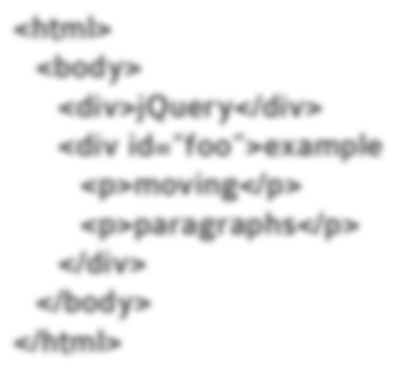
Moving Elements Examples
Move paragraphs to element with id “foo”
$(“p”).appendTo(“#foo”);
<html>
<body>
<div>jQuery</div>
<div id=”foo”>example
<p>moving</p>
<p>paragraphs</p>
</div>
</body>
</html>

Slide 52

Attributes

Slide 53


Attributes
Get
.attr(‘id’)

Slide 54

Attributes
Get
.attr(‘id’)
.html()

Slide 55

Attributes
Get
.attr(‘id’)
.html()
.val()

Slide 56

Attributes
Get
.attr(‘id’)
.html()
.val()
.css(“top”)

Slide 57

Attributes
Get
.attr(‘id’)
.html()
.val()
.css(“top”)
.width()

Slide 58



Attributes
Get
.attr(‘id’)
.html()
.val()
.css(“top”)
.width()
Set
.attr(‘id’, ‘foo’)

Slide 59

Attributes
Get
.attr(‘id’)
.html()
.val()
.css(“top”)
.width()
Set
.attr(‘id’, ‘foo’)
.html(“<p>hi</p>”)

Slide 60

Attributes
Get
.attr(‘id’)
.html()
.val()
.css(“top”)
.width()
Set
.attr(‘id’, ‘foo’)
.html(“<p>hi</p>”)
.val(“new val”)

Slide 61

Attributes
Get
.attr(‘id’)
.html()
.val()
.css(“top”)
.width()
Set
.attr(‘id’, ‘foo’)
.html(“<p>hi</p>”)
.val(“new val”)
.css(“top”, “80px”)

Slide 62

Attributes
Get
.attr(‘id’)
.html()
.val()
.css(“top”)
.width()
Set
.attr(‘id’, ‘foo’)
.html(“<p>hi</p>”)
.val(“new val”)
.css(“top”, “80px”)
.width(60)

Slide 63
Attributes

Slide 64

Attributes
Set border to 1px black
$(...).css(“border”, “1px solid black”);

Slide 65

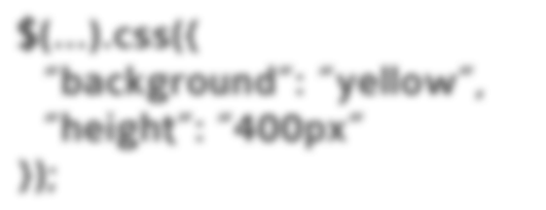
Attributes
Set border to 1px black
$(...).css(“border”, “1px solid black”);
Set various css properties.
$(...).css({
“background”: “yellow”, “height”: “400px”
});

Slide 66
Attributes
Set border to 1px black
$(...).css(“border”, “1px solid black”);
Set various css properties.
$(...).css({
“background”: “yellow”, “height”: “400px”
});
Set all link’s href attribute to google.com
$(“a”).attr(“href”, “http://google.com”);

Slide 67
Attributes

Slide 68

Attributes
Replace HTML with a new paragraph.
$(...).html(“<p>I’m new</p>”);

Slide 69


Attributes
Replace HTML with a new paragraph.
$(...).html(“<p>I’m new</p>”);
<div>whatever</div> turns into
<div><p>I’m new</p></div>

Slide 70
Attributes
Replace HTML with a new paragraph.
$(...).html(“<p>I’m new</p>”);
<div>whatever</div> turns into
<div><p>I’m new</p></div>
Set checkboxes attribute “checked” to checked.
$(“:checkbox”).attr(“checked”,”checked”);

Slide 71


Attributes
Replace HTML with a new paragraph.
$(...).html(“<p>I’m new</p>”);
<div>whatever</div> turns into
<div><p>I’m new</p></div>
Set checkboxes attribute “checked” to checked.
$(“:checkbox”).attr(“checked”,”checked”);
Set input value to 3.
$(...).val(“3”);

Slide 72


Attributes
Replace HTML with a new paragraph.
$(...).html(“<p>I’m new</p>”);
<div>whatever</div> turns into
<div><p>I’m new</p></div>
Set checkboxes attribute “checked” to checked.
$(“:checkbox”).attr(“checked”,”checked”);
Set input value to 3.
$(...).val(“3”);
Get input value.
$(...).val();

Slide 73

Events Examples

Slide 74

Events

Slide 75
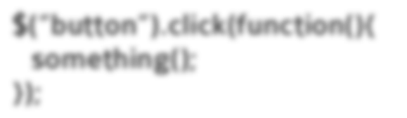
Events
When a button is clicked, do something.
$(“button”).click(function(){ something();
});

Slide 76
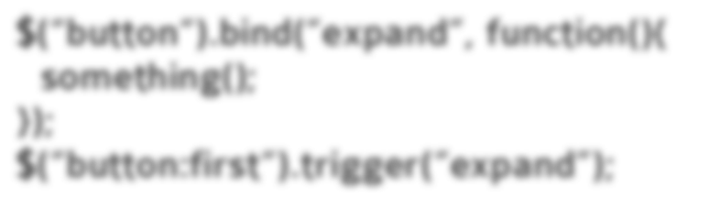
Events
When a button is clicked, do something.
$(“button”).click(function(){ something();
});
Setup a custom event and trigger it.
$(“button“).bind(“expand”, function(){ something();
});
$(“button:first“).trigger(“expand”);

Slide 77


Events
When a button is clicked, do something.
$(“button”).click(function(){ something();
});
Setup a custom event and trigger it.
$(“button“).bind(“expand”, function(){ something();
});
$(“button:first“).trigger(“expand”);
Unbind custom event.
$(“button“).unbind(“expand”);

Slide 78

Event Delegation

Slide 79

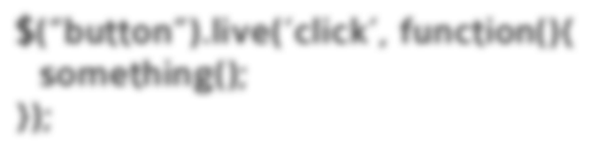
Event Delegation
Attach events to document
$(“button”).live(‘click’, function(){ something();
});

Slide 80
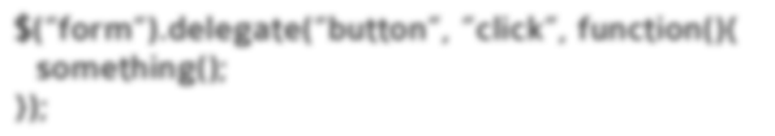
Event Delegation
Attach events to document
$(“button”).live(‘click’, function(){ something();
});
Attach event delegation to elements
$(“form“).delegate(“button”, ”click”, function(){ something();
});

Slide 81
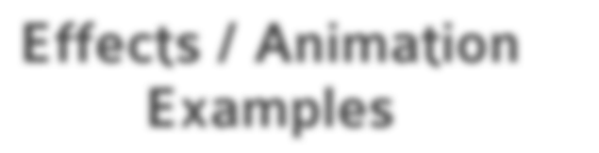
Effects / Animation Examples

Slide 82

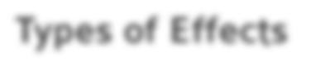
Animation / Effects
Types of Effects

Slide 83

Animation / Effects
Types of Effects
#1. Hide and Show

Slide 84

Animation / Effects
Types of Effects
#1. Hide and Show #2. Fade In and Out

Slide 85

Animation / Effects
Types of Effects
#1. Hide and Show #2. Fade In and Out
#3. Slide Up and Down

Slide 86
Animation / Effects

Slide 87
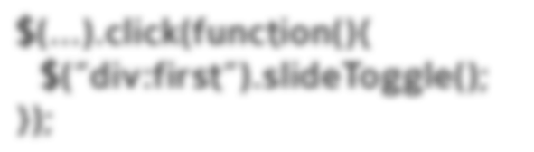
Animation / Effects
With each click, slide up / slide down a div.
$(...).click(function(){
$(“div:first”).slideToggle();
});

Slide 88
Animation / Effects
With each click, slide up / slide down a div.
$(...).click(function(){
$(“div:first”).slideToggle();
});
Animate elements to 300px wide in .5 seconds.
$(...).animate({ “width”: “300px” }, 500);

Slide 89
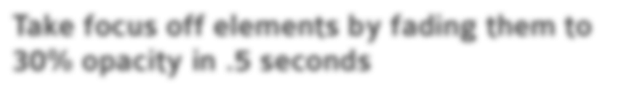

Animation / Effects
With each click, slide up / slide down a div.
$(...).click(function(){
$(“div:first”).slideToggle();
});
Animate elements to 300px wide in .5 seconds.
$(...).animate({ “width”: “300px” }, 500);
Take focus off elements by fading them to 30% opacity in .5 seconds
$(...).fadeTo(500, 0.3);

Slide 90

Traversing Examples

Slide 91


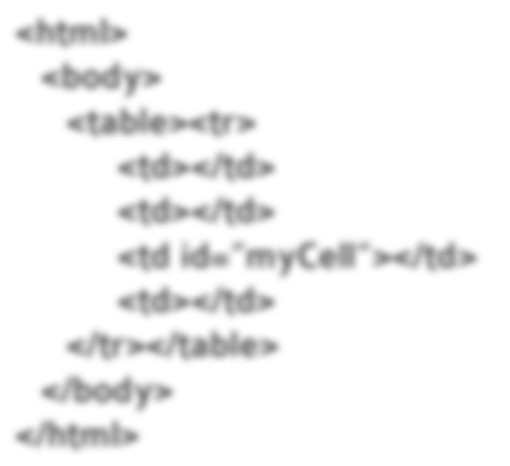
Traversing Examples
Get previous table cells to #myCell.
$(“#myCell”)
<html>
<body>
<table><tr>
<td></td>
<td></td>
<td id=”myCell”></td>
<td></td>
</tr></table>
</body>
</html>

Slide 92

Traversing Examples
Get previous table cells to #myCell.
$(“#myCell”).prevAll()
<html>
<body>
<table><tr>
<td></td>
<td></td>
<td id=”myCell”></td>
<td></td>
</tr></table>
</body>
</html>

Slide 93

Traversing Examples
Get previous table cells to #myCell.
$(“#myCell”).prevAll().andSelf();
<html>
<body>
<table><tr>
<td></td>
<td></td>
<td id=”myCell”></td>
<td></td>
</tr></table>
</body>
</html>

Slide 94

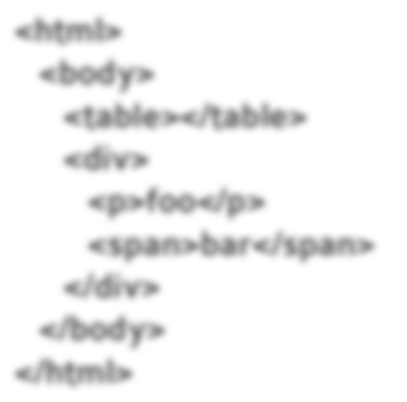
Traversing Examples
Move paragraphs to element with id “foo”
$(“table”)
<html>
<body>
<table></table>
<div>
<p>foo</p>
<span>bar</span>
</div>
</body>
</html>

Slide 95

Traversing Examples
Move paragraphs to element with id “foo”
$(“table”).next()
<html>
<body>
<table></table>
<div>
<p>foo</p>
<span>bar</span>
</div>
</body>
</html>

Slide 96
Traversing Examples
Move paragraphs to element with id “foo”
$(“table”).next()
<html>
<body>
<table></table>
<div>
<p>foo</p>
<span>bar</span>
</div>
</body>
</html>

Slide 97

Traversing Examples
Move paragraphs to element with id “foo”
$(“table”).next().find(“p”);
<html>
<body>
<table></table>
<div>
<p>foo</p>
<span>bar</span>
</div>
</body>
</html>

Slide 98

Ajax Examples

Slide 99
Ajax Examples
$.ajax({
method: "POST",
url: "some.php",
data: { name: "John", location: "Boston" }
})

Slide 100
Ajax Examples
$.ajax({
method: "POST",
url: "some.php",
data: { name: "John", location: "Boston" }
})

Slide 101

Wait, There’s More!

Slide 102
jQuery isn’t only about simpler code

Slide 103


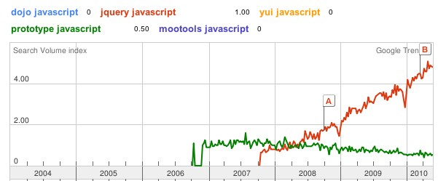
Led to World Domination
jQuery
http://google.com/trends?q=dojo+javascript,+jquery+javascript,+yui+javascript,+prototype
+javascript,+mootools+javascript&ctab=0&geo=all&date=all&sort=1

Slide 104


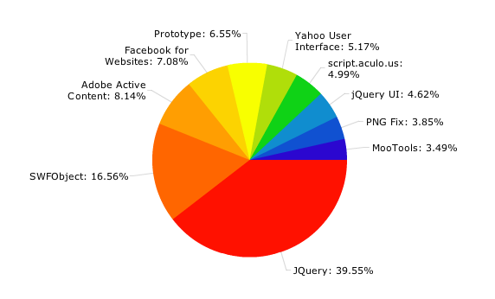

Usage Across Top 10,000 Sites
http://trends.builtwith.com/javascript

Slide 105

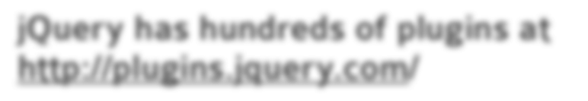

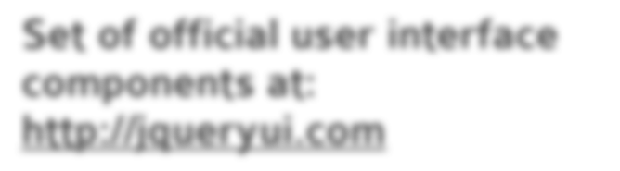
Plugins
jQuery has hundreds of plugins at http://plugins.jquery.com/
jQuery UI
Set of official user interface components at: http://jqueryui.com

Slide 106





Support
jQuery general discussion mailing list
http://forum.jquery.com
jQuery discussion docs page
http://docs.jquery.com/Discussion
jQuery IRC room
#jquery on FreeNode.net

Slide 107


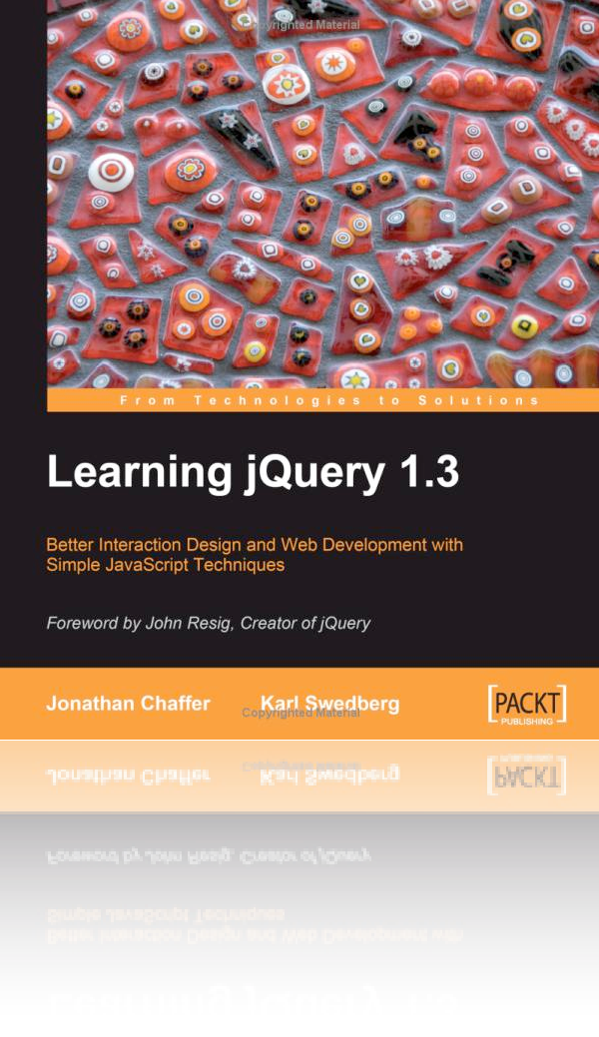

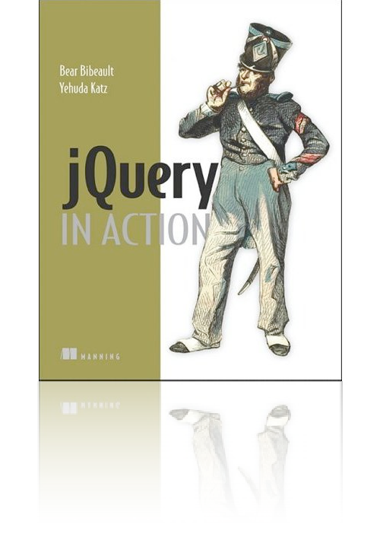
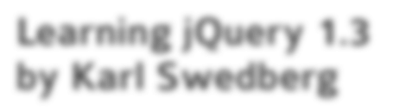

Books
Learning jQuery 1.3 by Karl Swedberg
http://www.amazon.com/gp/product/1847196705? ie=UTF8&tag=jacofalltrawe-20&linkCode=as2&cam p=1789&creative=9325&creativeASIN=1847196705
jQuery in Action Yahuda Katz
http://www.amazon.com/gp/product/1933988355? ie=UTF8&tag=jacofalltrawe-20&linkCode=as2&camp
=1789&creative=9325&creativeASIN=1933988355

